Slide 1
Decision Tree and Ensemble Learning
Session 15-16

Slide 2
Learning Outcome
LO 1: Explain the fundamental of machine learning concept
LO 2: Interpret the distribution of dataset using regression method
LO 3: Experiment classification and clustering algorithm from given dataset

Slide 3
Outline
Decision Tree
Introduction to Ensemble Learning
Bagging
Boosting
Random Forest
Stacking

Slide 4
Decision Tree

Slide 5
Decision Tree
Decision tree algorithms can be considered as iterative, top-down construction method for the hypothesis (classifier). You can picture a decision tree as a hierarchy of decisions, which are forking or dividing a dataset into subspaces.
The tree has three types of nodes:
A root node that has no incoming edges and zero or more outgoing edges
Internal/Decision nodes, each of which has exactly one incoming edge and two or more outgoing edges
Leaf or terminal nodes, each of which has exactly one incoming edge and no outgoing edges.
Splitting: The process of dividing a node into multiple sub-nodes.
Branch: A subsection of the decision tree consisting of multiple nodes

Slide 6
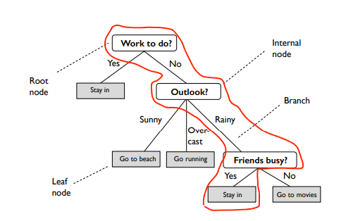
Decision Tree

Slide 7
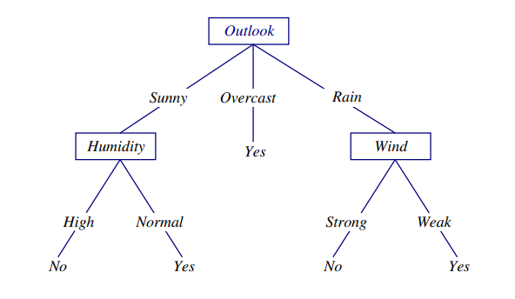
Decision Tree
Decision Tree Operation
Each instance holds attribute values
Instances are classified by filtering the attribute values down the decision tree, down to a leaf which gives the final answer
Internal nodes: attribute names or attribute values. Branching occurs at attribute nodes.

Slide 8
Decision Tree
Training process
Decision trees are built by recursively splitting our training samples using the features from the data by evaluating certain metrics, like the Gini index or the Entropy for categorical decision trees.
The process for discrete features: all of its possible values are evaluated, resulting in N calculated metrics for each of the variables, being N the number of possible value for each categorical value.
For continuous features: the mean of each two consecutive values (ordered from lowest to highest) of the training data are used as possible thresholds.

Slide 9
Decision Tree
Making prediction
Predicting the category or numerical target value of a new sample is very easy using Decision Trees.
Start at the root node, look at the value of the feature that it evaluates, and depending on that value go to the left or right children node.
This process is repeated until we reach a leaf node.
When this happens, the predicted category would be the mode of the categories on that leaf node.

Slide 10
Introduction Ensemble Learning

Slide 11
Introduction Ensemble Learning
In broad terms, using ensemble methods is about combining models to an ensemble such that the ensemble has a better performance than an individual model on average.
The main categories of ensemble methods involve (1) voting schemes among high variance models to prevent “outlier” predictions and overfitting, and (2) the other involves boosting “weak learners” to become “strong learners.”

Slide 12
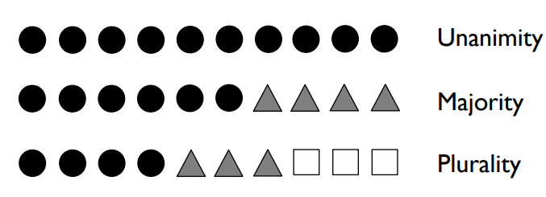
Introduction Ensemble Learning
Majority Voting
We will use the term “majority” throughout this lecture in the context of voting to refer to both majority and plurality voting
Plurality: mode, the class that receives the most votes; for binary classification, majority and plurality are the same

Slide 13
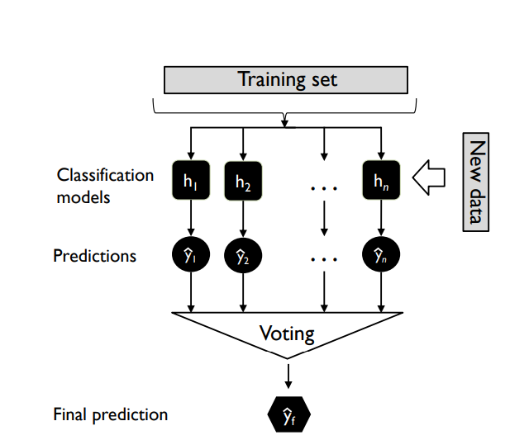
Introduction Ensemble Learning
Majority Voting

Slide 14
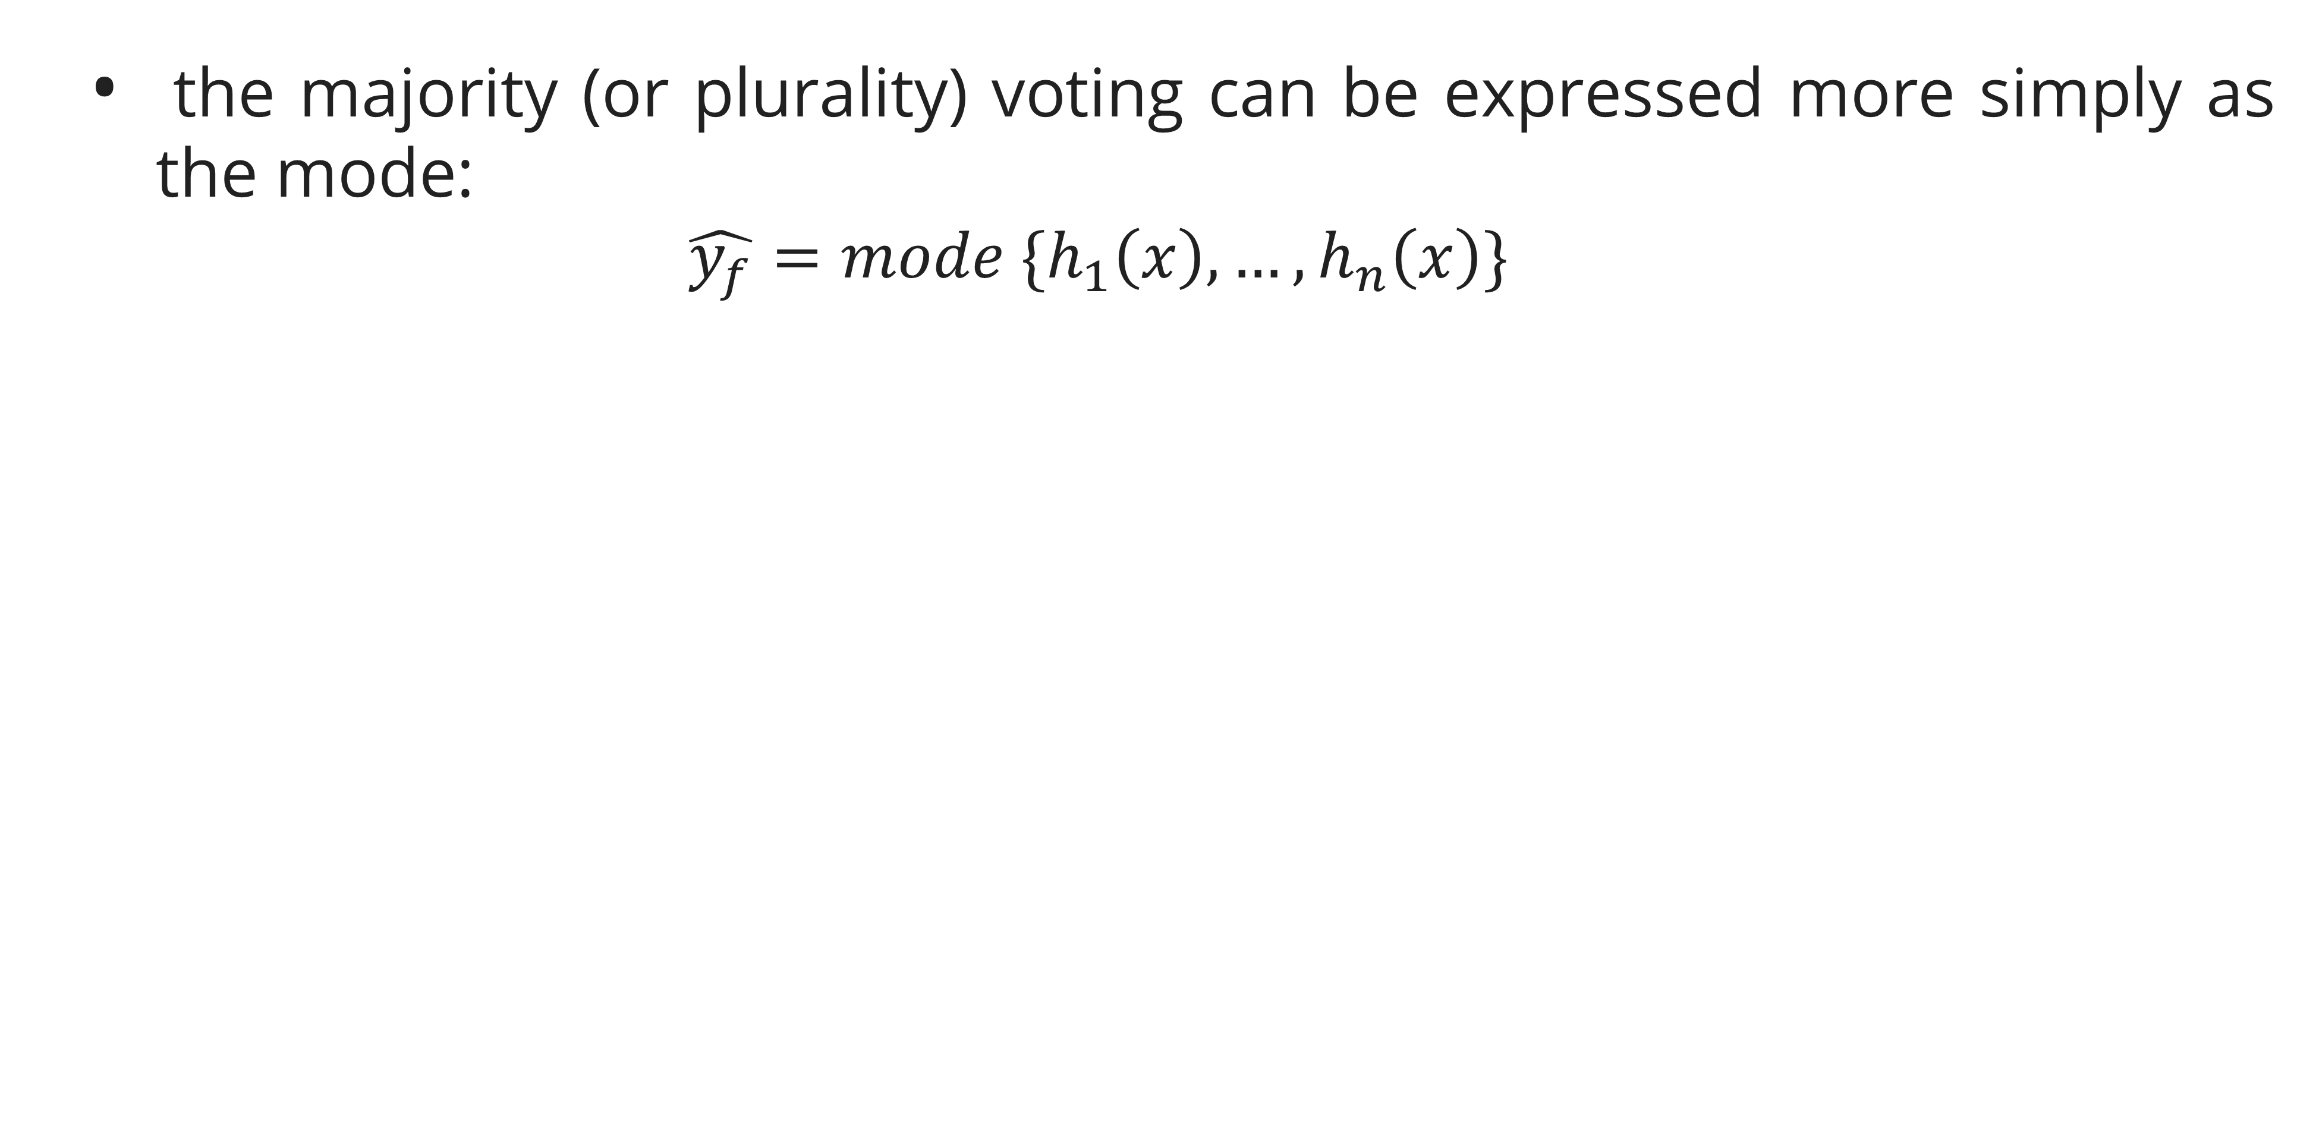
Introduction Ensemble Learning
Majority Voting
the majority (or plurality) voting can be expressed more simply as the mode:
$$\hat{y_{f}}=mode \{h_{1}\left(x\right),…, h_{n}\left(x\right)\}$$

Slide 15
Bagging

Slide 16
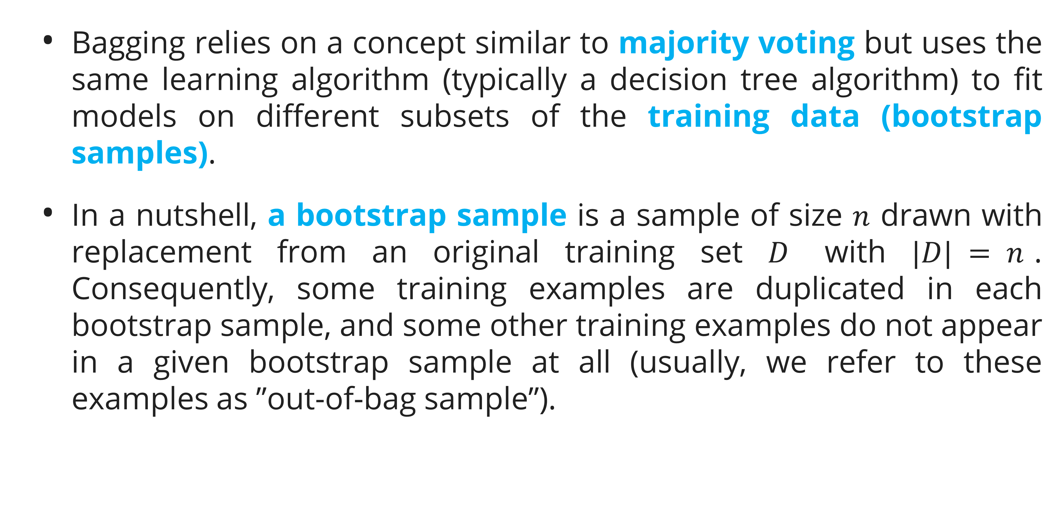
Bagging
Bagging relies on a concept similar to majority voting but uses the same learning algorithm (typically a decision tree algorithm) to fit models on different subsets of the training data (bootstrap samples).
In a nutshell, a bootstrap sample is a sample of size $n$ drawn with replacement from an original training set $D$ with $|D| = n$. Consequently, some training examples are duplicated in each bootstrap sample, and some other training examples do not appear in a given bootstrap sample at all (usually, we refer to these examples as ”out-of-bag sample”).

Slide 17
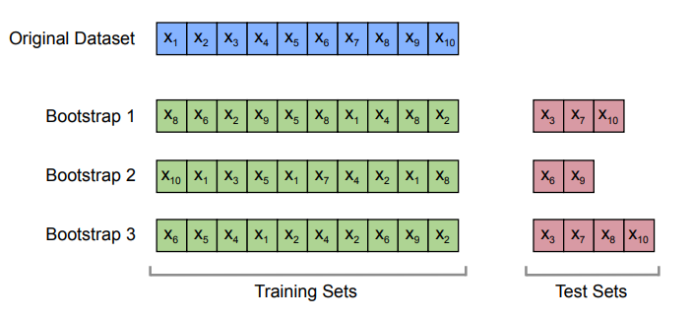
Bagging
Illustration of bootstrap sampling

Slide 18
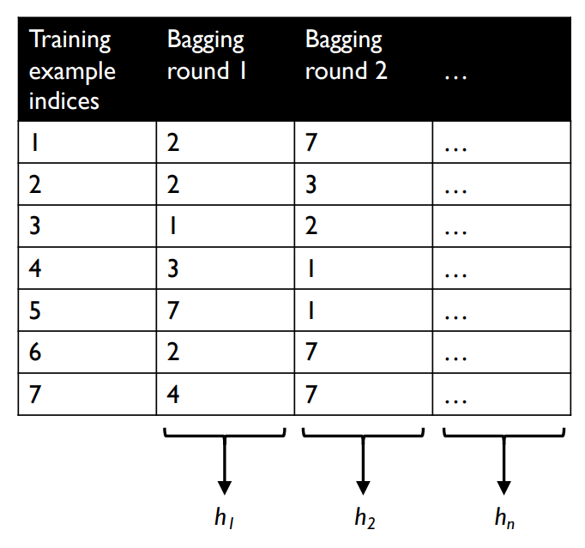
Bagging
Illustration of bootstrapping in the context of bagging

Slide 19
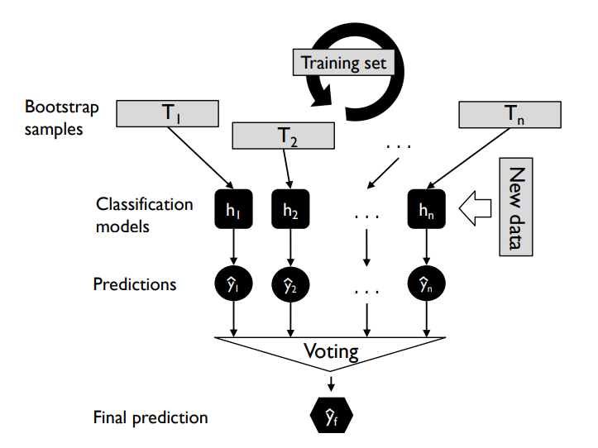
Bagging
The concept of bagging

Slide 20
Boosting

Slide 21
Boosting
There are two broad categories of boosting: Adaptive boosting and gradient boosting.
Adaptive and gradient boosting rely on the same concept of boosting “weak learners” (such as decision tree stumps) to “strong learners.
Boosting is an iterative process, where the training set is reweighted, at each iteration, based on mistakes a weak learner made (i.e., misclassifications); the two approaches, adaptive and gradient boosting, differ mainly regarding how the weights are updated and how the classifiers are combined

Slide 22
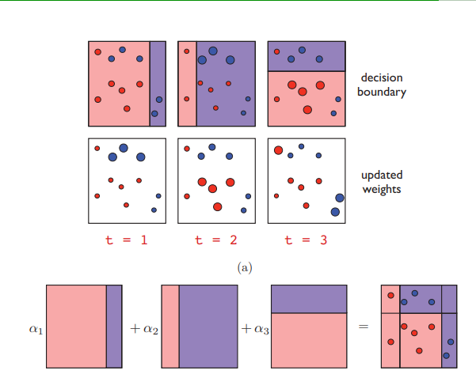
Boosting
Adaboost

Slide 23
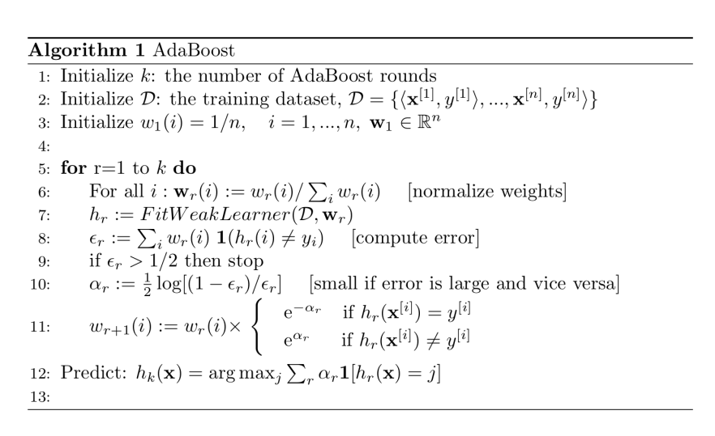
Boosting
Adaboost

Slide 24
Random Forest

Slide 25
Random Forest
Random forests are among the most widely used machine learning algorithm, probably due to their relatively good performance “out of the box” and ease of use (not much tuning required to get good results)
In the context of bagging, random forests are relatively easy to understand conceptually: the random forest algorithm can be understood as bagging with decision trees, but instead of growing the decision trees by basing the splitting criterion on the complete feature set, we use random feature subsets

Slide 26
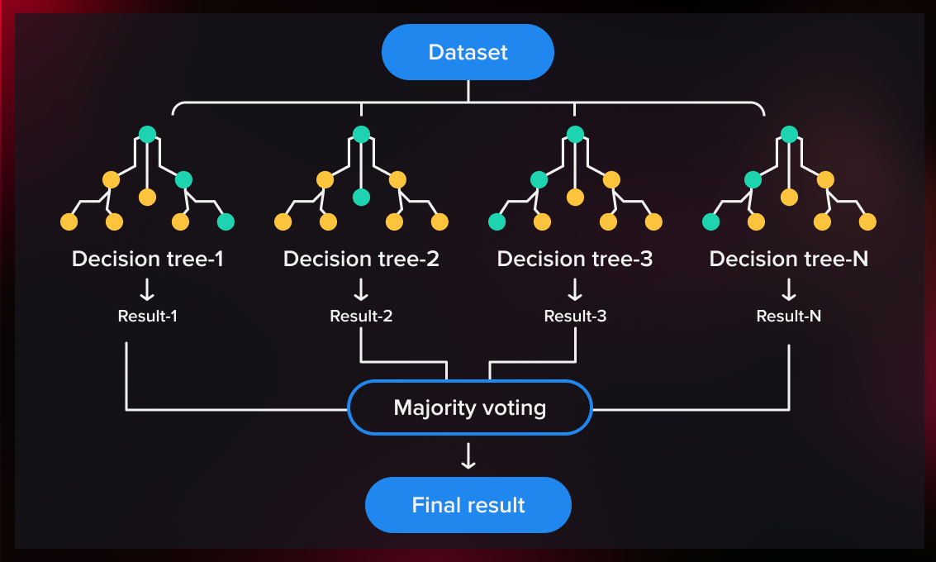
Random Forest

Slide 27
Stacking

Slide 28
Stacking
Stacked generalization or Stacking involves training a new learning algorithm to combine the predictions of several base learners.
First, we train the base learners using training data.
Then a combiner, called the meta model, is trained to make a final prediction based on the predictions of the base learners.
Unlike boosting, which combines several weak learners, stacking is designed to ensemble a diverse group of strong learners.
Here, instead of a sequence of models, a single model is used to learn how to best combine the predictions from different base models in consideration.

Slide 29
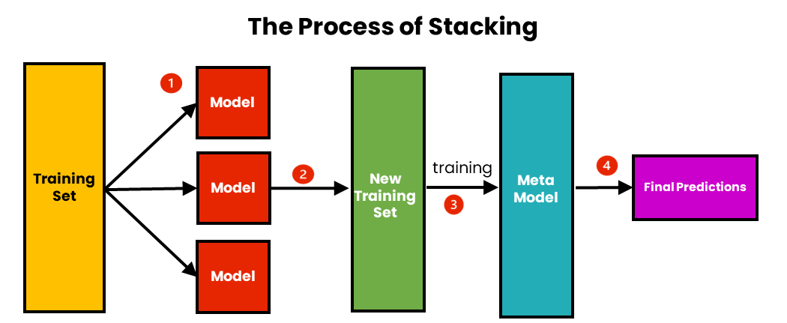
Stacking

Slide 30
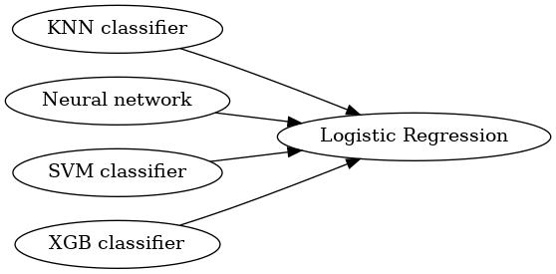
Stacking

Slide 31
Exercise

Slide 32
Exercise
You are a data scientist tasked with analyzing the Titanic dataset. The ultimate goal of your analysis is to build a model that can predict which passengers survived the Titanic disaster (https://www.kaggle.com/competitions/titanic). Your objective is to build a logistic regression model to predict the binary outcome of survival for the Titanic passengers.
Split the dataset into a training set and a testing set to evaluate your model's performance (70:30).
Develop a Decision Tree, Random Forest, and Adaboost model using your selected features.
Evaluate the performance of your previous model using metrics such as accuracy, precision, recall, and the ROC-AUC score.
Provide a detailed analysis of the confusion matrix to understand the true positives, false positives, true negatives, and false negatives.

Slide 33
References

Slide 34
References
Curry, R. (2022, January 2). AdaBoost: Explained! Medium. https://medium.com/@curryrowan/adaboost-explained-92408a6713da
Géron, A. (2019). Hands-on machine learning with Scikit-Learn, Keras, and TensorFlow: Concepts, tools, and techniques to build intelligent systems (Second edition). O’Reilly.
James, G., Witten, D., Hastie, T., Tibshirani, R., & Taylor, J. E. (2023). An introduction to statistical learning: With applications in Python. Springer.
Raschka, S. (2020a). Decision Tree. STAT 451: Machine Learning Lecture Notes. https://sebastianraschka.com/pdf/lecture-notes/stat451fs20/06-trees__notes.pdf
Raschka, S. (2020b). Ensemble Learning. STAT 451: Machine Learning Lecture Notes. https://sebastianraschka.com/pdf/lecture-notes/stat451fs20/07-ensembles__notes.pdf
Raschka, S., Liu, Y., Mirjalili, V., & Dzhulgakov, D. (2022). Machine learning with PyTorch and Scikit-Learn: Develop machine learning and deep learning models with Python. Packt.

